Slide 1
LOST &
FOUND
BING NEWS MOBILE
DESIGN EXPLORATION
Yifei Gong September 2019

Slide 2
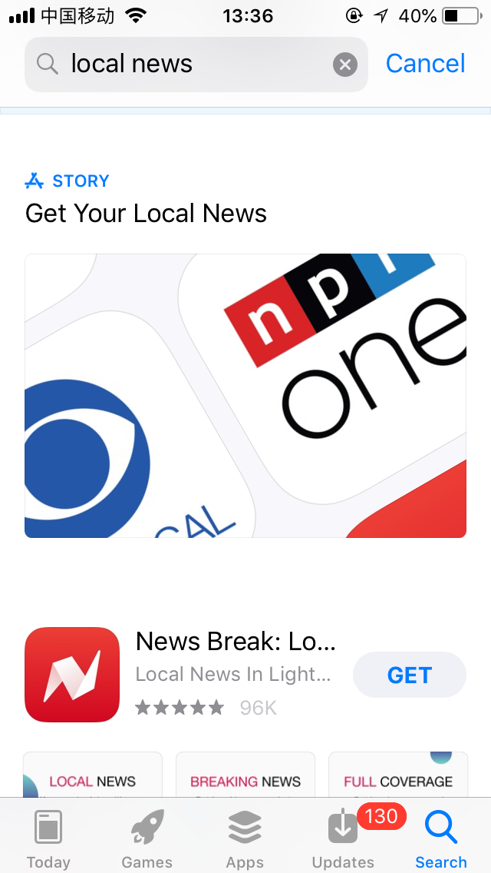

Slide 3
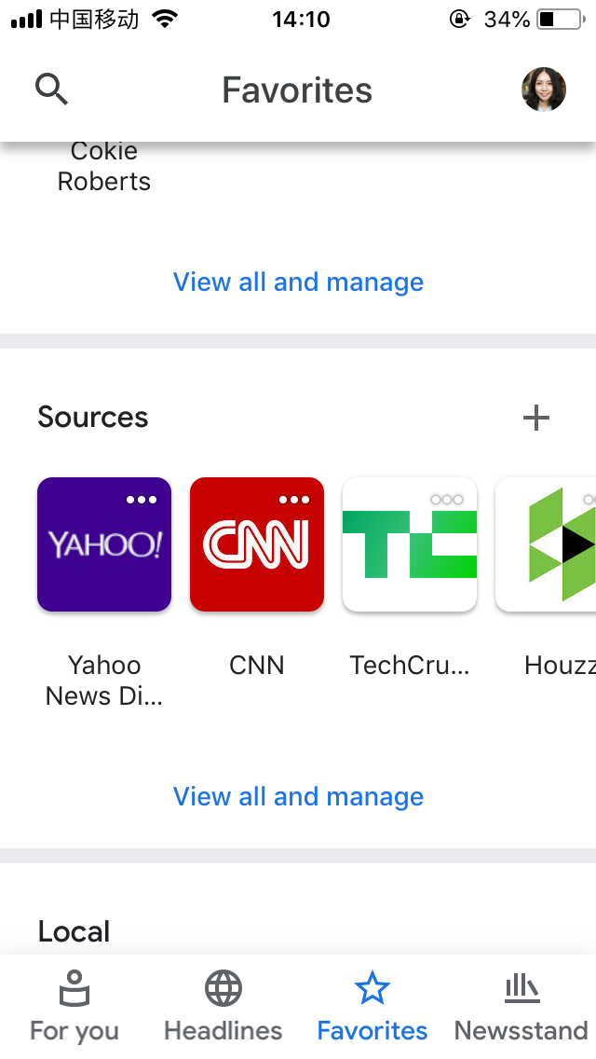
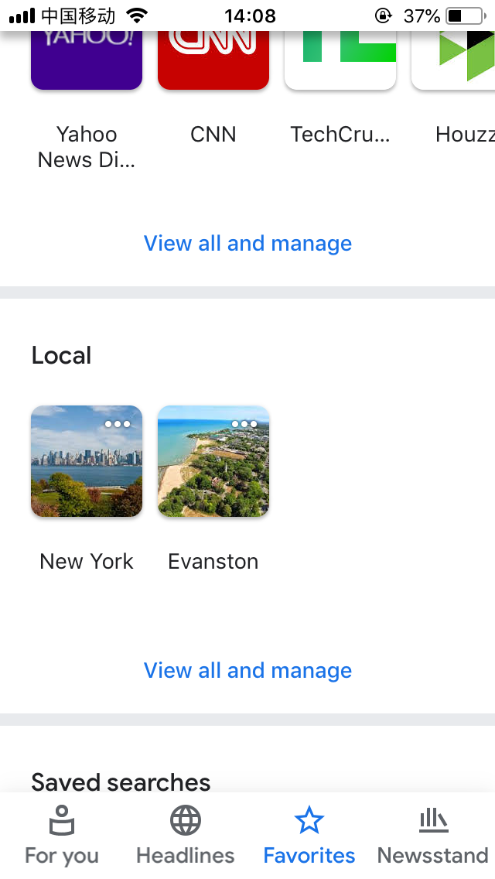
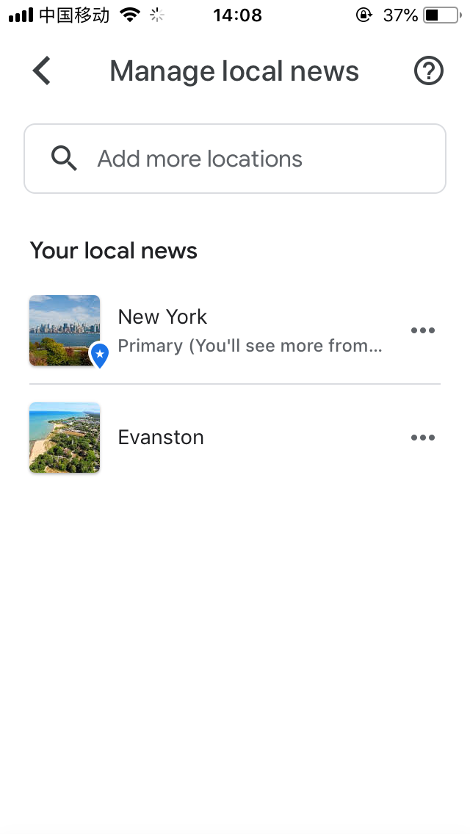
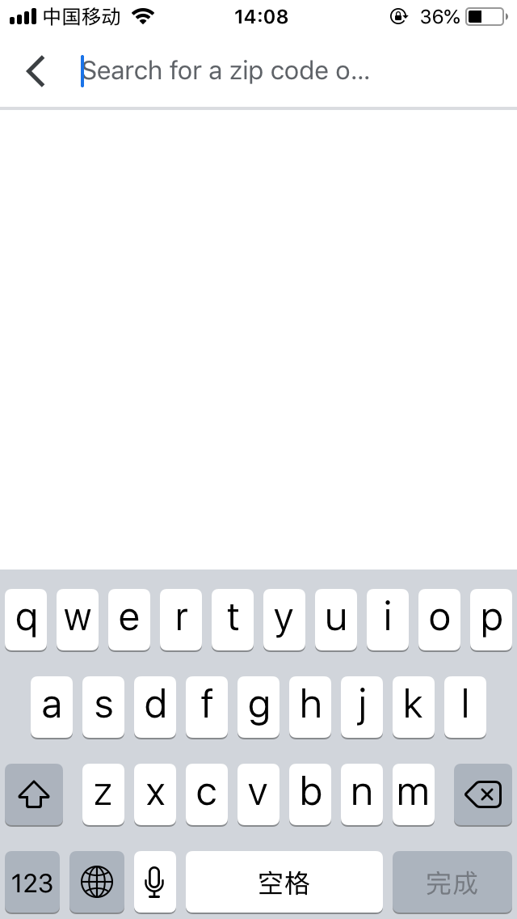
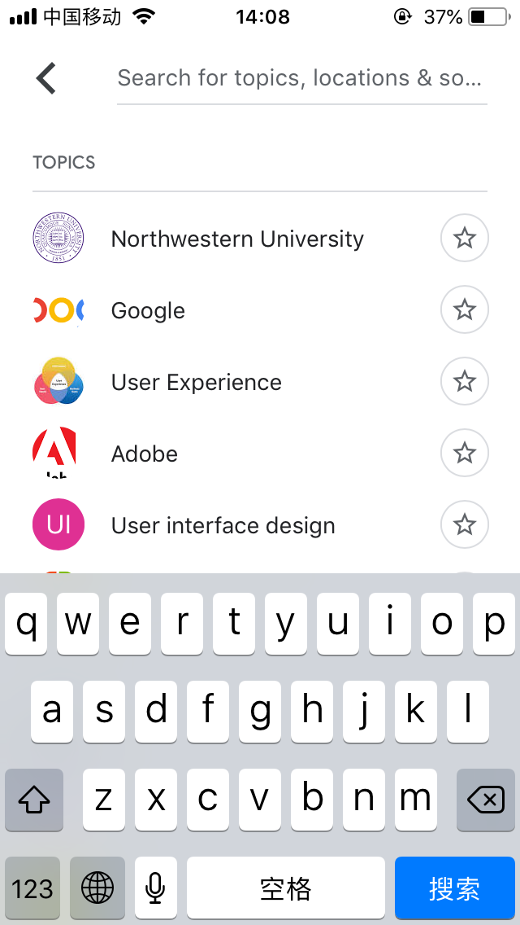

Slide 4
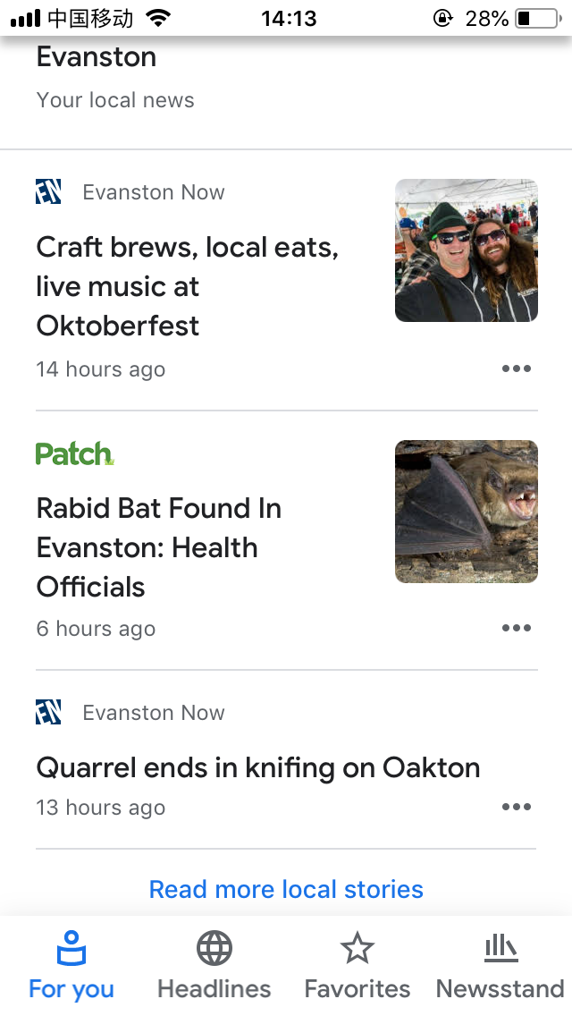
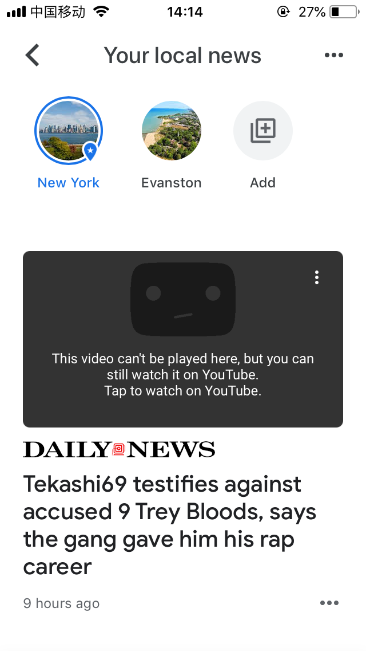
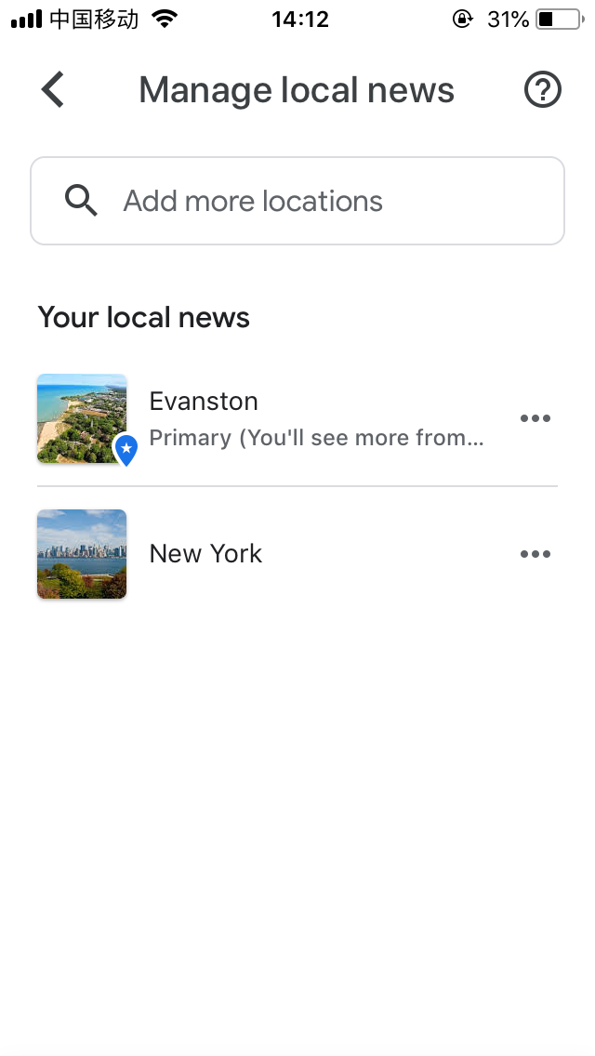

Slide 5
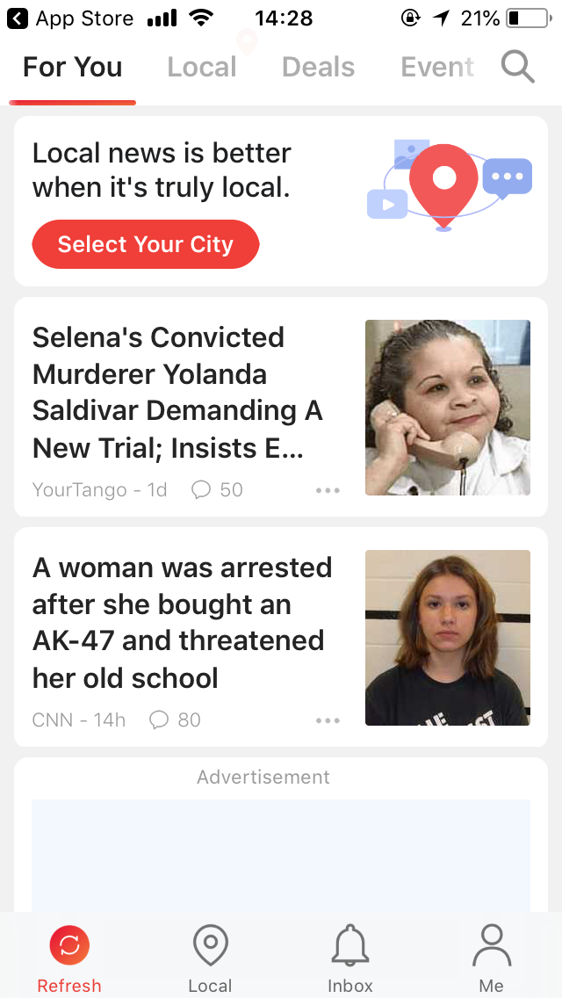
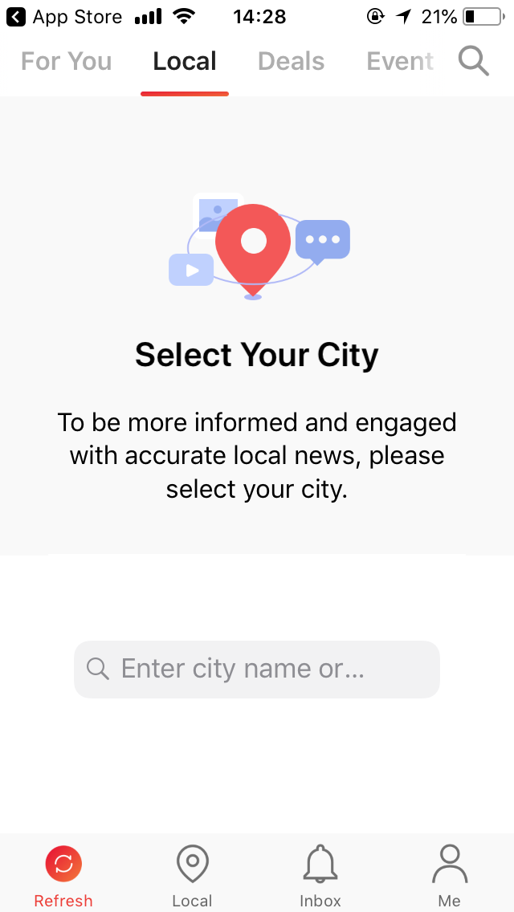
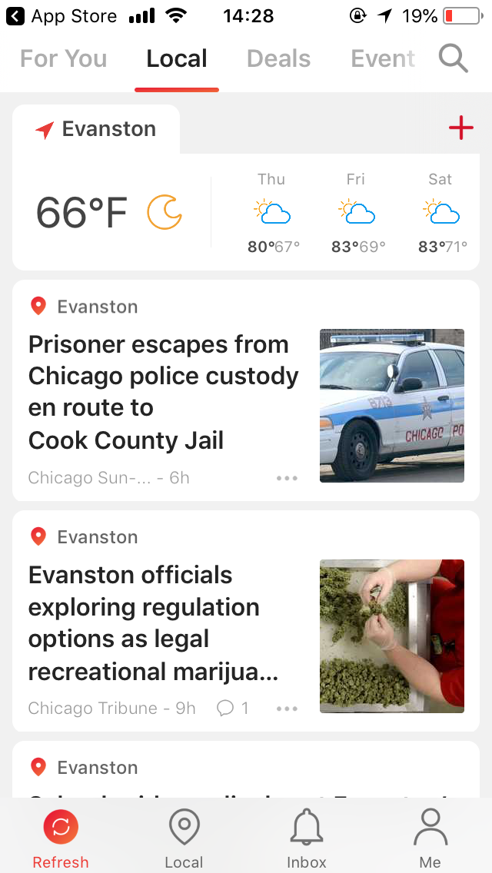
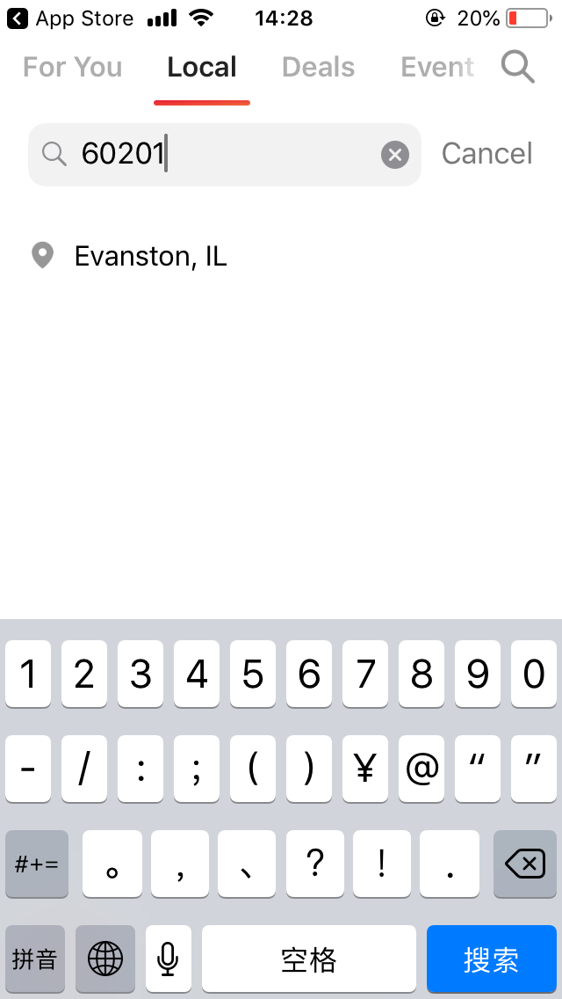

Slide 6
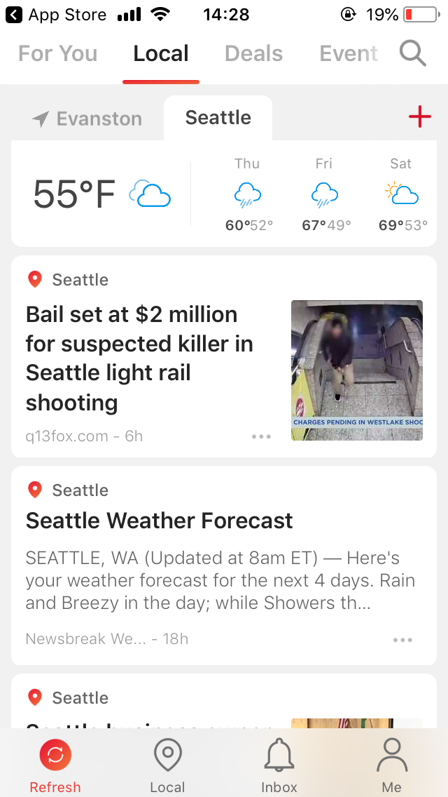
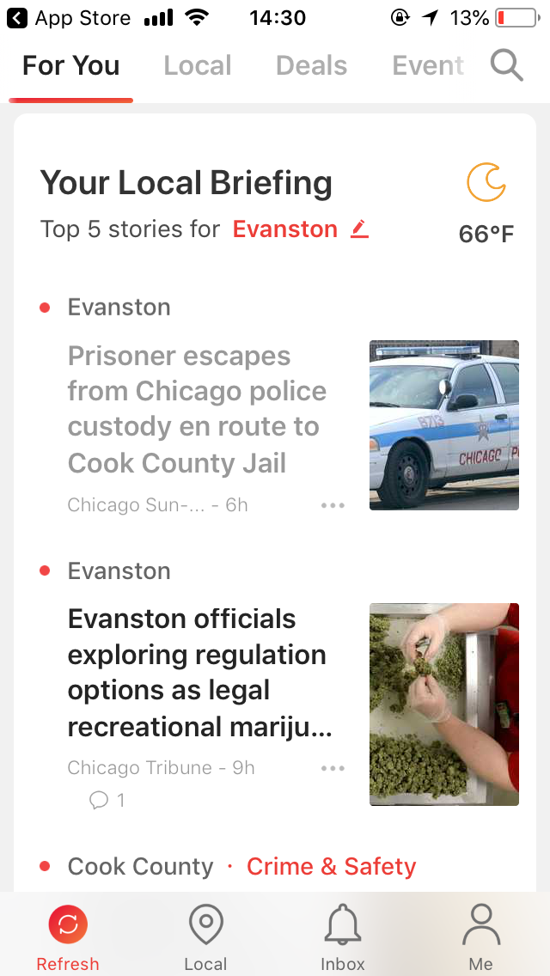

Slide 7
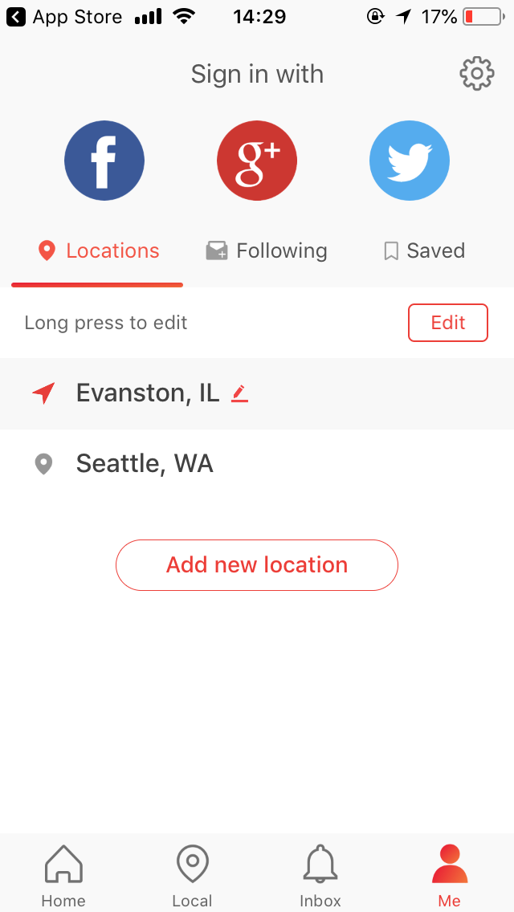
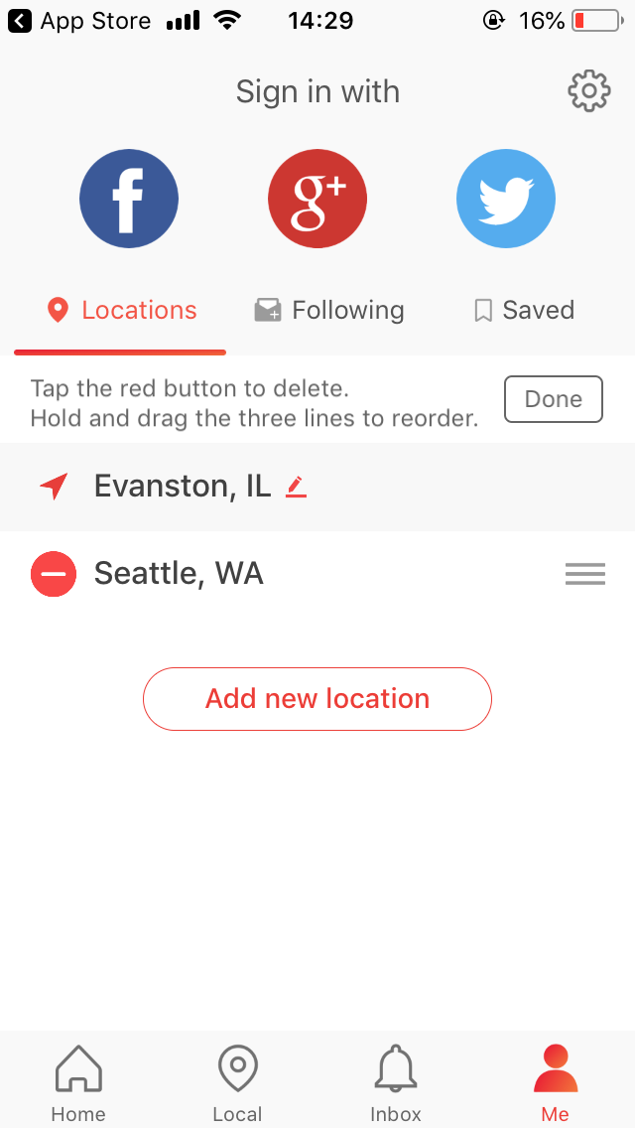

Slide 8
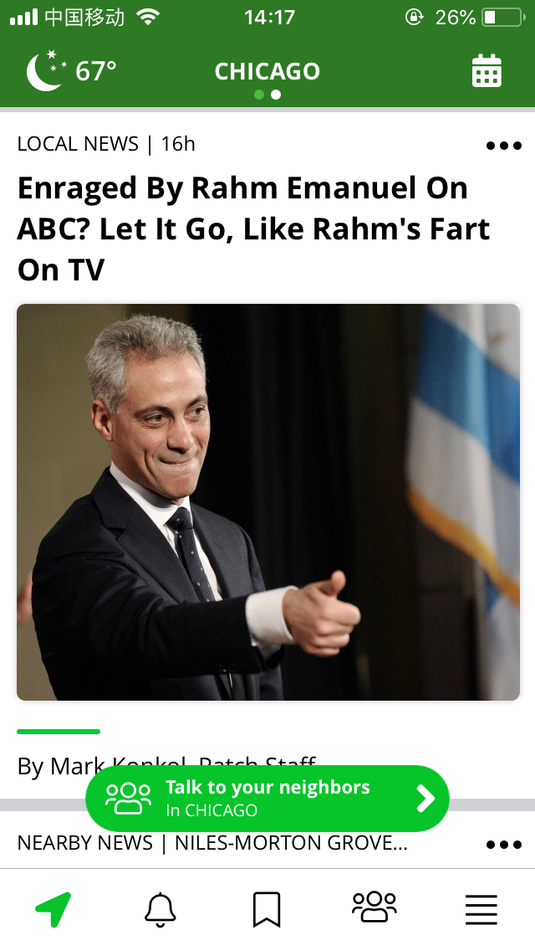
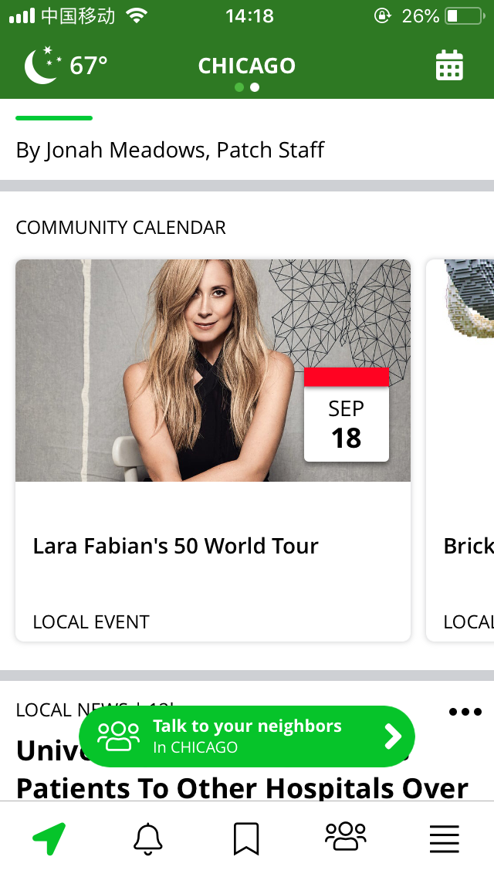
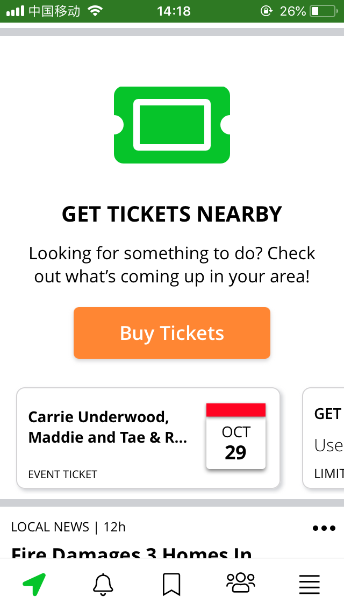
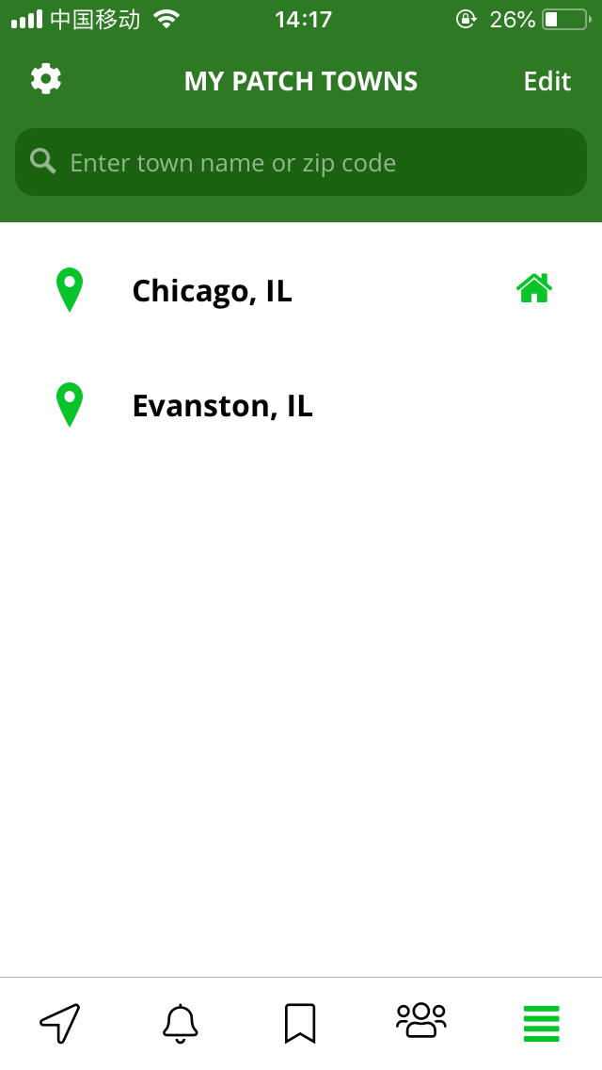
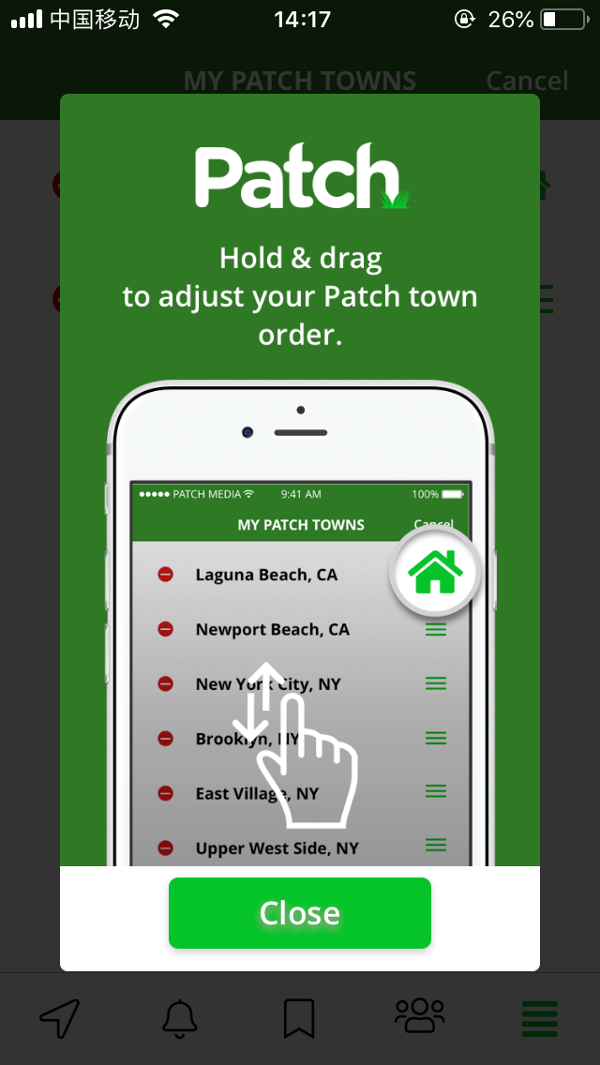
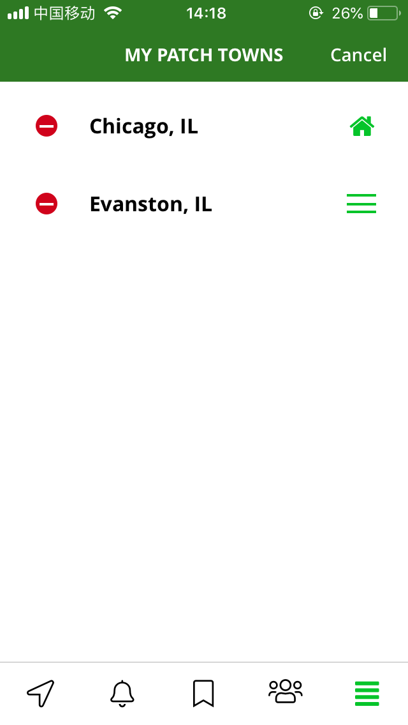

Slide 9
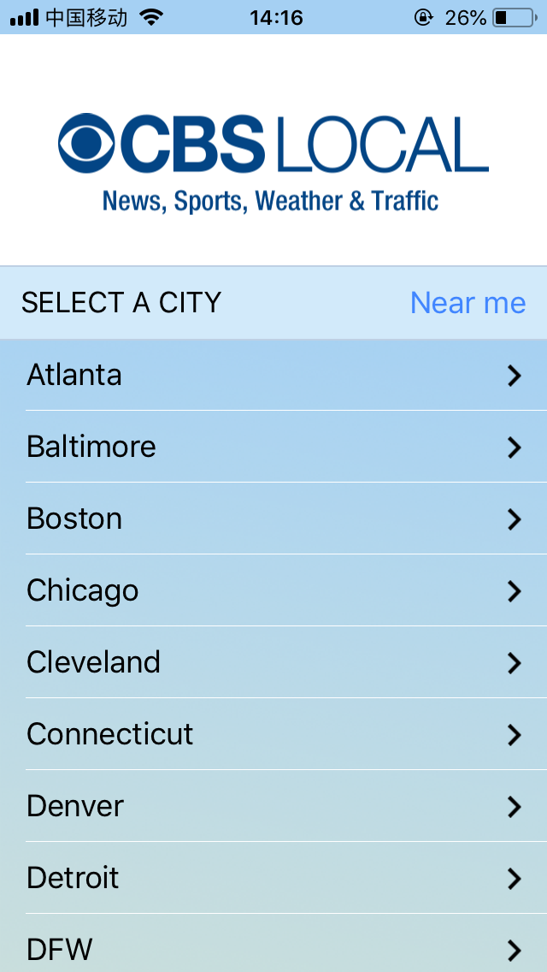
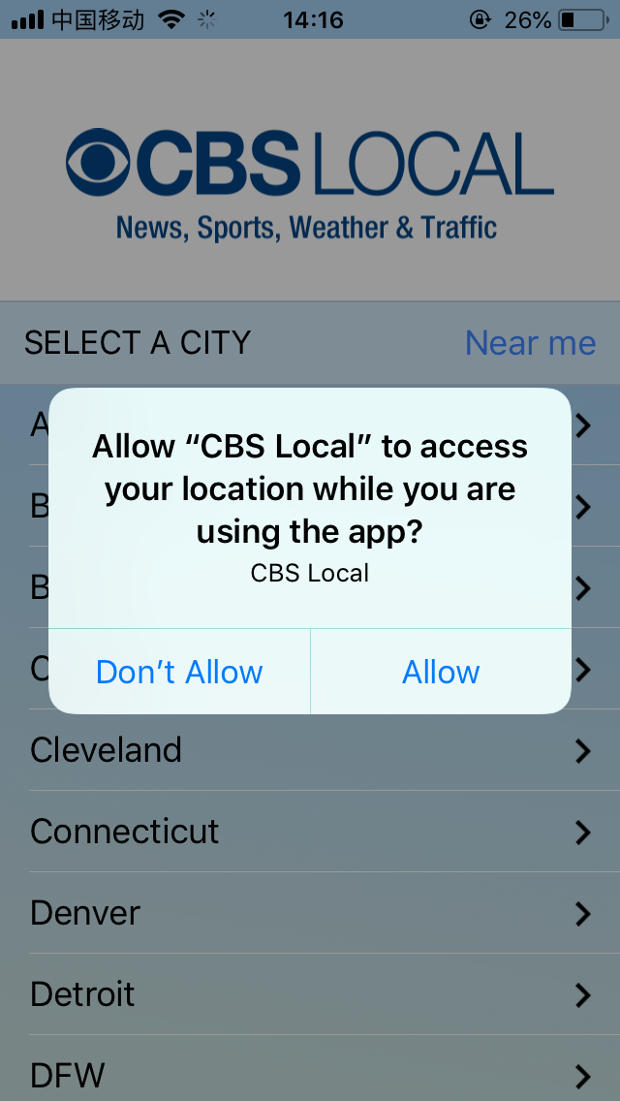
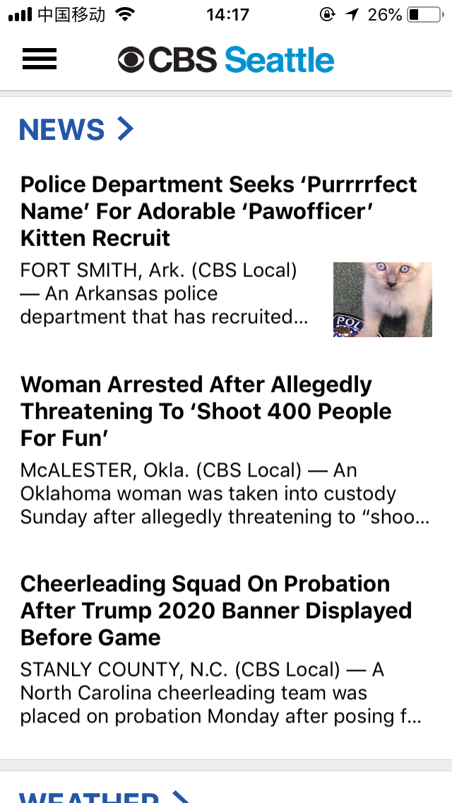
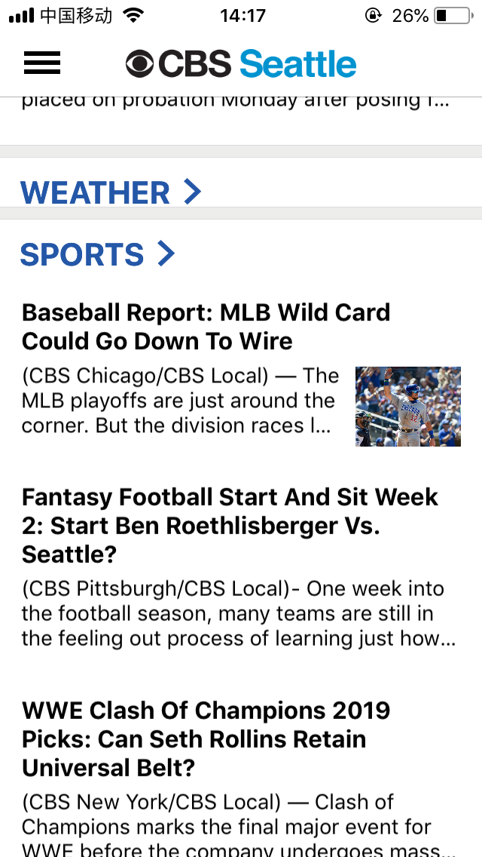
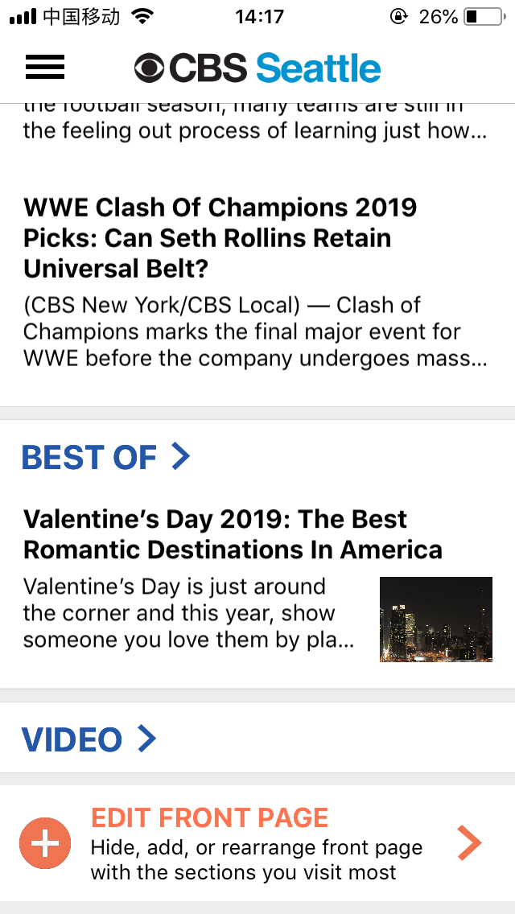

Slide 10
Current Stage
Bing News Vertical
Mobile Design
New version(2019) design ready for implementing
Notes:
So I’m going to unpack each current pain point and solution one by one.
The first one is lost focus which brought by long reading list, quick scrolling down and view the content in a same pattern.
People’s perception is getting flatten.

Slide 11
Starting point
NEWS=BREAKING

Slide 12
READ NEWS=BORING
Notes:
News is a breaking image in common sense. But when people talking about is, people feel like reading news is boring.

Slide 13
Unmeted PAIN POINTS
Lost Relevance
Interest and location
Lost Focus
Less importance and time differentiation
Notes:
The reasons behind it through my research are while reading new, lost focus, lost interest an lost update make them feel actively reading news is boring.

Slide 14
LOST
Notes:
Lost is certainly a passive word to describe the current experience.

Slide 15
FOUND
Opportunity AREA
Notes:
And the solutions I’ve explored are around Found.

Slide 16
PAIN POINT 1
LOST RELEVANCE
Feel the content is not relevant to me
Notes:
But there is another part of this problem, why people lost their focus on our design, may be they couldn’t find the topics they are interested in.

Slide 17
Direction 1
Personalized Content
Notes:
But there is another part of this problem, why people lost their focus on our design, may be they couldn’t find the topics they are interested in.

Slide 18
Make a more personalized for you feed
HMW

Slide 19
Ideal perception
For you=Content relevant to me

Slide 20

Barrier
Mobile news app users say they want personalized content, but few have taken steps to get it.
Mobile News Apps Survey Results, June 2017
Notes:
What could attract their focus?

Slide 21
Design direction
How to make the content personalization easier and more accessible?

Slide 22
Solution 1
First time set up

Slide 23
Awareness
Action
Engagement
Evaluation

Slide 24
1Awareness
HMW make first time knowing that the content on opal is personalize

Slide 25
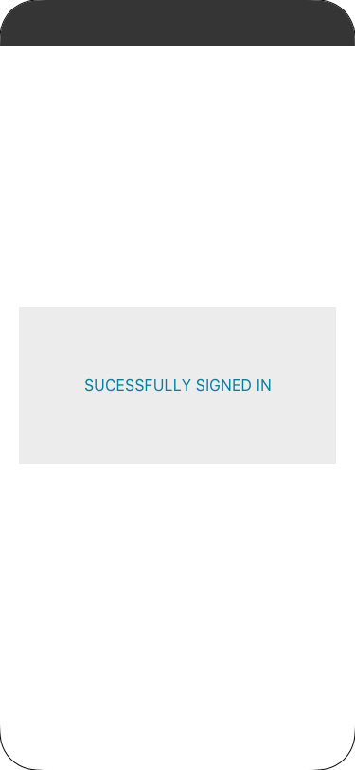
1Awareness
Starting point: After users first time signed in

Slide 26
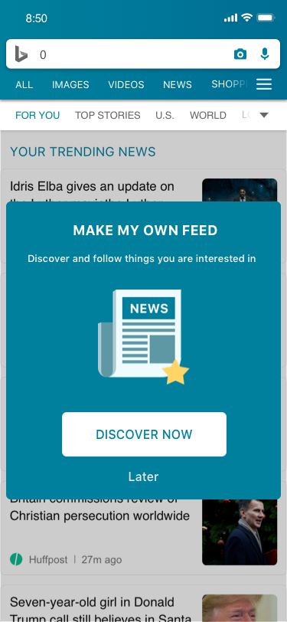
NOT PERSONALIZED POP UP
Have intention to personalize content now
A pop up to let them know they could get personalized content
Show when users follow topic is blank
Tap [discover now] jump to content personalization page
Tap [later] jump close the pop up

Slide 27

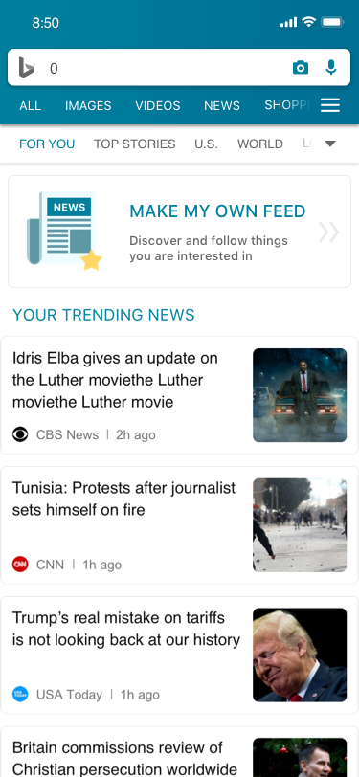
LATER ENTRY POINT
Not have intention to personalize content now
The pop up close and transform to a window on the top of the [for you] page

Slide 28
Content personalization

Slide 29
2Action
HMW make a more accessible and visible follow function when uses intent to follow topics
Clear interaction and status indication

Slide 30
Expectation
People want easier, more immediate ways to personalize their feed to make it more useful and engaging.
Mobile News Apps Survey Results, June 2017
Notes:
What could attract their focus?

Slide 31
2Action
Existed
Search result
Comprehensive page-more news
Proposed
First time personalization pop up
Comprehensive view page improvement

Slide 32
CENTRALIZED CONTENT PERSONALIZATION PAGE
A page allow to view trending topics, search topics and follow topic
Intentions
Users have had target topics(existed in their mind) to follow-search
Follow is to see updates-latest trending topics

Slide 33
DESIGN 1
Cards Carousel
Recommendation, user passive
Pros:
topics organized by group, clear
Cons:
Roughly follow topics users are not interested in

Slide 34
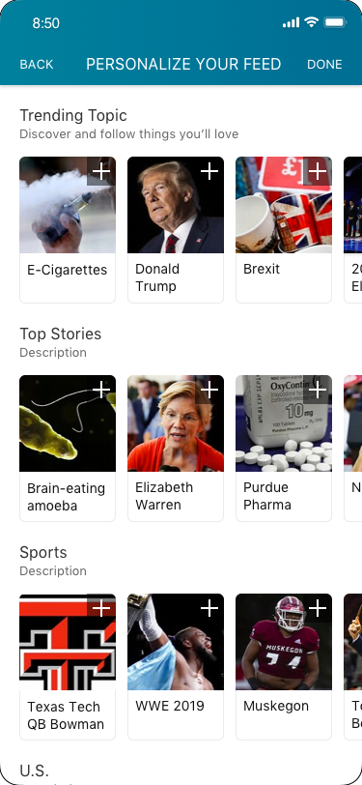
View

Slide 35
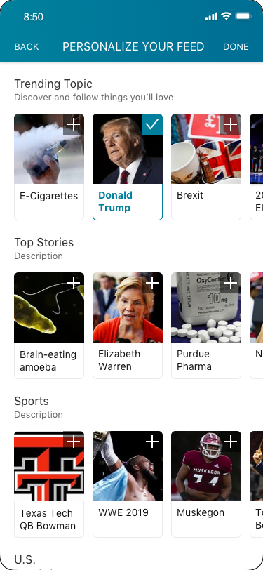
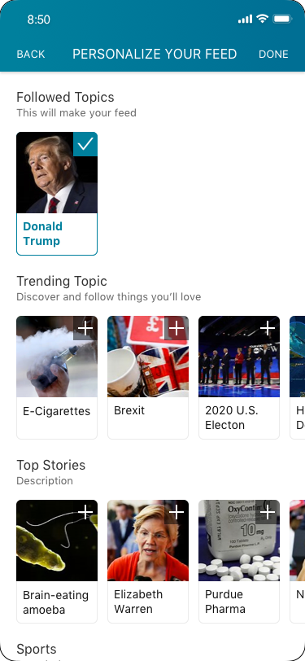
Selected
Design 1
Design 2
Group selected cards

Slide 36
COMPETITOR ‘S SOLUTION
Search-oriented
Google News
Feed
Reuters
Feed +Navi

Slide 37
DESIGN 2
Topics List
Exploration, user active
Pros
Could access both trending topics and targetd topics

Slide 38
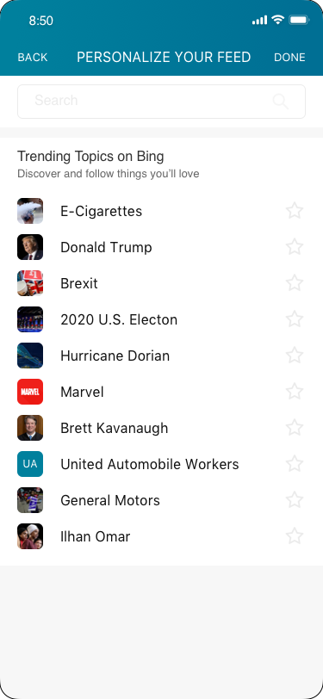
View

Slide 39
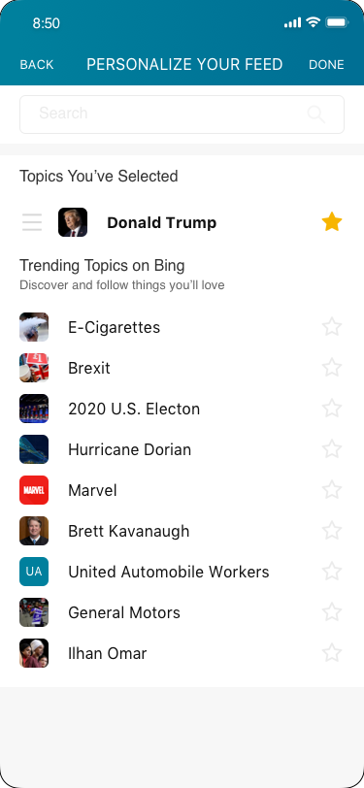
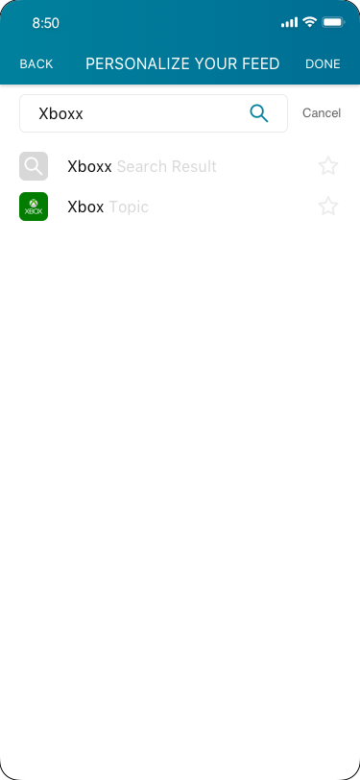

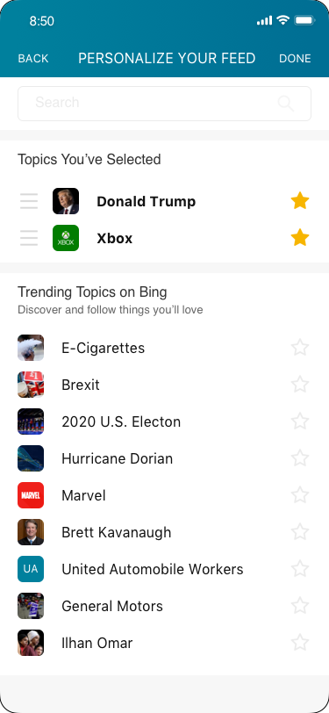
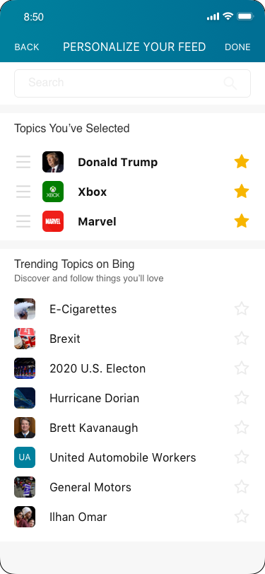
DESIGN 2 USER FLOW

Slide 40
3Engagement
HMW make the for you tab feel more relevant to you

Slide 41
Expectation
Users prefer content to be organized by category/topic.
Mobile News Apps Survey Results, June 2017
Notes:
What could attract their focus?

Slide 42
3Engagement
Design direction
Make users see the topics they followed clearly

Slide 43
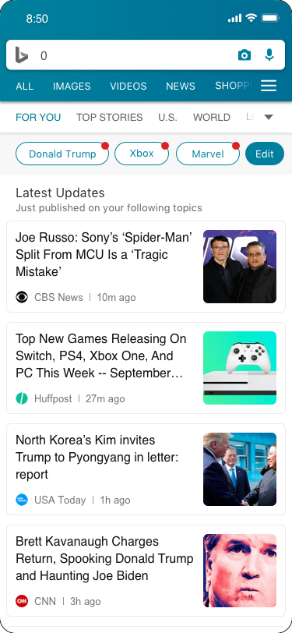
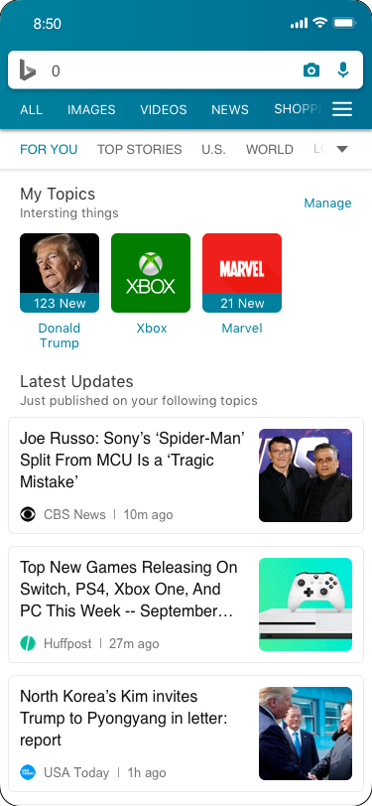
3Engagement
Sub navi

Slide 44
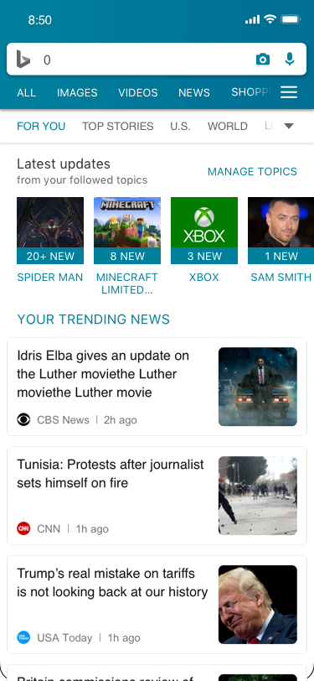
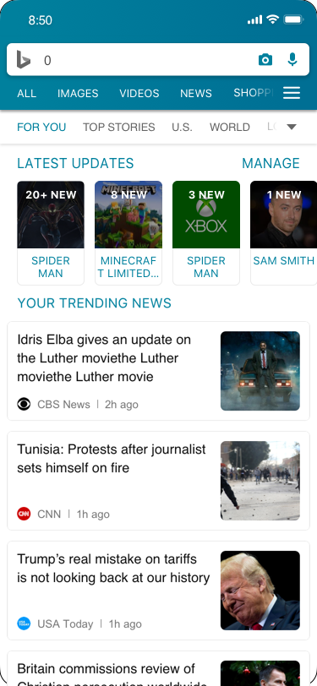
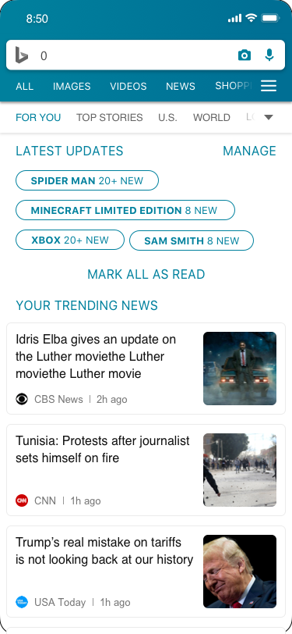
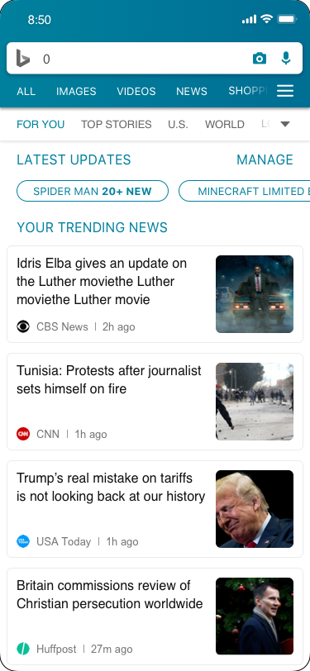
Design 1
Design 2
Design 3
Design 4

Slide 45
Awareness
Action
Engagement
Evaluation

Slide 46
4Evaluation
HMW make a more

Slide 47
Intention
Unfollow not preferable topics to make content of for you more relevant
Explore new topics

Slide 48
4Evaluation
Manage page
1 add new
2 delete old
(3)manually ordering

Slide 49
4Evaluation
Manage page

Slide 50
Design 1 Intention fir

Slide 51
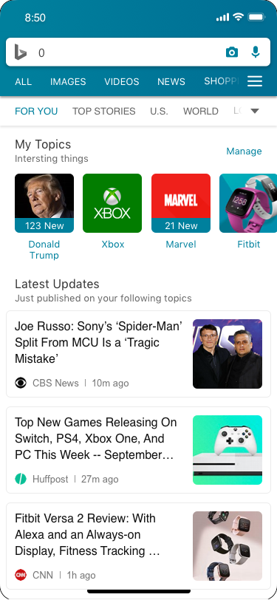
Add new
“Fitbit” Search result
Espresso Card
Follow
“Fitbit” Comprehensive view page
Espresso Card

Slide 52
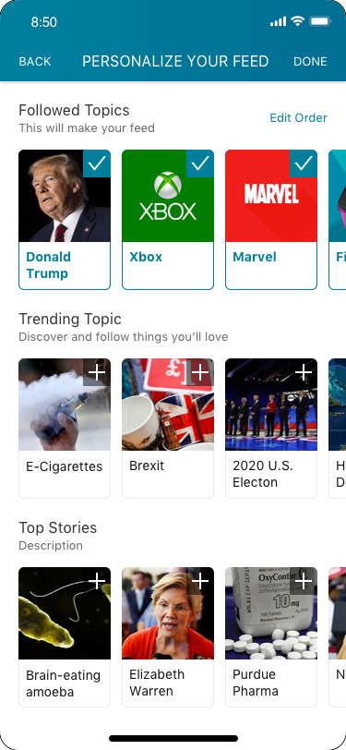
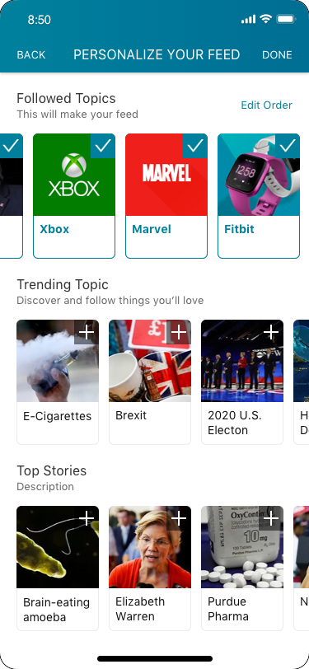
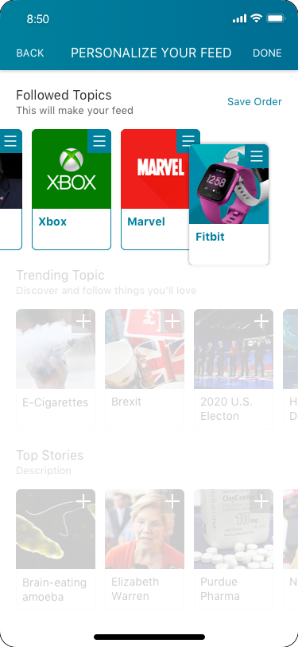
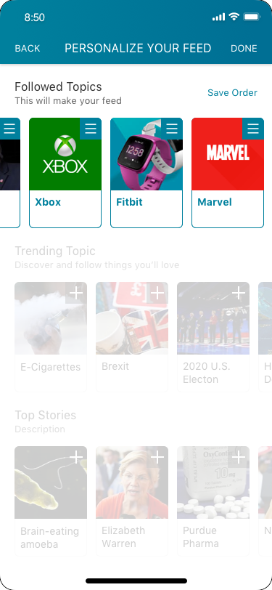

Manipulate order
View current
Scroll horizontally
Drag
Locate and release
View result

Slide 53




Unfollow
View Current
Undo Design 1
Undo Design 2
Complete

Slide 55





Add new
View current
Search
Save topic
View result

Slide 56




Manipulate order

Slide 57



Unfollow
Undo Design 1
Undo Design 2

Slide 58
DIRECTION 2
SPACE DIMENSION
Notes:
But there is another part of this problem, why people lost their focus on our design, may be they couldn’t find the topics they are interested in.

Slide 59



Slide 60



Slide 61
Expectation
Users prefer content to be organized by category/topic.
Mobile News Apps Survey Results, June 2017
Notes:
What could attract their focus?

Slide 62
Barrier
Mobile news app users say they want personalized content, but few have taken steps to get it.(1)
Mobile News Apps Survey Results, June 2017
Notes:
What could attract their focus?

Slide 63
Expectation
People want easier, more immediate ways to personalize their feed to make it more useful and engaging.
Mobile News Apps Survey Results, June 2017
Notes:
What could attract their focus?

Slide 64
Desktop [Interest] related features
haven’t be aligned
Gap

Slide 65

CURRENT DESIGN
Only on desktop, they could manage their interest.

Slide 66
User Journey
See a new topic
Follow the topic
Read current content
Know update
Read update
Manage

Slide 67

User flow 1 follow and read
Entry Point
See the topic
Follow the topic
Read current content
Search Result
Follow
Comprehensive View Page
Browse News
All interests

Slide 68
BING NEWS SPOTLIGHT
11
11

Slide 69

ENTRY POINT-SEARCH RESULT
Current design
Topic follow card
User feedback
The topic follow button doesn’t make sense to users.(mobile user study 2019)
“I don’t know I’m gonna follow what.”

Slide 70



Reuters
Search
Follow
Entry point and feed

Slide 71


ENTRY POINT 1 SEARCH RESULT
Proposal
Change the ux writing to follow +topic name
Make the follow button into the main section, mix with name, description and picture

Slide 72

COMPETITORS
Google News Favorite Tab
Reuters My feed

Slide 73




1. ENTRY POINT-BROWSE NEWS
Single
Separate Pop up
Single
Separate In list
Group
Mix In list
Group
Seperate page

Slide 74

Follow Interest Card
Requirements
Interest Name
Follow
Unfollow
Entry Hot Spot
(Thumbnail)
(Summary)

Slide 75



FOLLOW All Interests List-Recommend Mode
Carousel
View all the category
List
Smoothly scrolling
2 Column List
Efficient
Cards Collection
Immersive

Slide 76


FOLLOW All Interests List-Explore Mode
Top Search Bar
Bottom Search Bar

Slide 77


1. ENTRY POINT-COMPREHENSIVE VIEW PAGE
Icon
More

Slide 78
READ
Comprehensive view Pages

Slide 79

User flow 2
Manage
Follow
Unfollow
Follow
Follow
My Interests Page

Slide 80




FOLLOWED MANAGEMENT
AP News
Microsoft News
Google News

Slide 81

2. MANAGE
Card Requirements
Interest Name
Full coverage entrance
Unfollow

Slide 82


FOLLOW My Interests List
List View
Show more items
Clear for reading
2 Column List
Fill the whitespace
More direct by pics

Slide 83
FOLLOW CTA Button Status
Successfully Follow Notification
Status
Unfollow
Status
Followed
Successfully Unfollow Notification

Slide 84


FOLLOW Follow/unfollow Notification
Bottom
Pop up

Slide 85


COMPETITORS
Google News Tab3
LinkedIn
Post saved status

Slide 86


3. SIGN-IN
If didn’t sign-in, pop up the sign-in notification

Slide 87


MANAGE: FOLLOW/UNFOLLOW
3. Sign-in
Reuters
11

Slide 88

4. Sign-in
Since the experience is embedded in the opal app, so the entry point would be less visible if we put this in the setting.
And also the current navigation is less useful for topics since they are on last position of the bar. It takes too much efforts to scroll down to that part.

Slide 89
User flow

Slide 90
After followed something, users want to keep in track but sometimes they are unable to read the updates or forget their reading progress.
Follow-up

Slide 91
PAIN POINT 2
LOST FOCUS
233
Notes:
So I’m going to unpack each current pain point and solution one by one.
The first one is lost focus which brought by long reading list, quick scrolling down and view the content in a same pattern.
People’s perception is getting flatten.

Slide 92
Perception is getting flatten and feeling boring since
1. Not well importance differentiated
2. Not well time differentiated

Slide 93
PAIN POINT 1
LOST FOCUS
Long reading list with same pattern would make users feel boring
Notes:
So I’m going to unpack each current pain point and solution one by one.
The first one is lost focus which brought by long reading list, quick scrolling down and view the content in a same pattern.
People’s perception is getting flatten.

Slide 94

Current Problem
While emerging in browsing the news list with some repeated pattern, the perception is getting flattened.

Slide 95
Focus
How to create this point
To catch user’s focus back
Reading Time
When did they lost focus
Notes:
When do they feel lost

Slide 96
Showcase

Slide 97
Wrap-up 1
List View
233

Slide 98
Wrap-up 2
Comprehensive View
233

Slide 99
Wrap-up 3
Top Stories Browsing
233

